Slide 1

Artificial Intelligence &
Machine Learning
Workshop on Artificial Intelligence
Konstantinos Kostis
SciFY.org
This work by Konstantinos Kostis is licensed under a
Creative Commons Attribution-ShareAlike 3.0 Unported License.
Based on a work at www.scify.org
Α SciFY Academy presentation
“Sharing knowledge, we become better”

Slide 2
Indigo – A Robot tour guide for museums

Slide 3

Konstantinos Kostis kekostis@gmail.com
First things first – who am I
Informatics at AUEB
Intern student at NCSR “Demokritos” (IIT,SKEL)
where I worked on AI and Machine Learning
Volunteer Software Engineer at a Not-for Profit Organization
Selected Technical Student at CERN

Slide 4
Some definitions
What is Artificial Intelligence?
It is a branch(field) of computer science that studies
and develops intelligent machines and software
What does AI research include?
pretty much EVERYTHING

Slide 5
Some definitions...
What does AI research include?
  Deduction , Reasoning &
  Problem Solving (Logic,Assumptions)
  Knowledge Representation
    Objects and their relations
    Ontologies
  Planning(Scheduling and Intelligent agents)
  Learning (Known as Machine Learning)

Slide 6
Some definitions...
Some definitions...
What does AI research include?
  Natural Language Processing
    Reading and Understanding the languages that humans speak
  Motion & Manipulation(Robotics)
    Object manipulation
    Navigation
  Perception (Machine Perception,Computer Vision & Speech Recognition)

Slide 7
Some definitions...
Social Intelligence
  Study and development of systems and devices that can
    Recognize
    Interpret
    Process
    Simulate
Human Effects
Creativity
General intelligence
  Describes a hypothetical artificial intelligence that
    Matches or exceeds Human Intelligence ,so
    A machine could perform any intellectual task as a human being can

Slide 8
What we will do today
We are going to build an email filter software so that given an email we can categorize it as good (HAM) or bad (SPAM)

Slide 9


Slide 10
How are we going to do this?
Take advantage of
  Machine Learning
  Sub-field of Artificial Intelligence
  Construction and study of systems that can learn from data

Slide 11
Use of Machine Learning
Object Recognition (eg Robotics)
Natural Language Processing
Search engines
Recommendation Systems
Opinion-Mining(Sentiment Analysis)
Medical Diagnosis
BioInformatics
...and many others

Slide 12
Vocabulary
Data is everything that gives us information. It can be text,numbers,document,math formula...
Dataset is a collection of data
Training Dataset is the collection of data that we use to learn from
Test Dataset is the collection of data on which we apply a model in order to see how well we learned from our data
Model is what we actually learn from data
Preprocessing is the removal of stop-words(such as 'and','or','the'...) , of special characters and/or numbers from a text

Slide 13
Taxonomy of ML Algorithms
Supervised Learning
  Training on labelled data
  Attempts to
    Generalize a function/mapping between input and output
    Use the function for prediction
Unsupervised Learning
  Operates on Unlabelled data
  Attempts to
    Discover structure in data
Semi-Supervised Learning
Combines both labelled and unlabelled examples to generate an appropriate function.

Slide 14
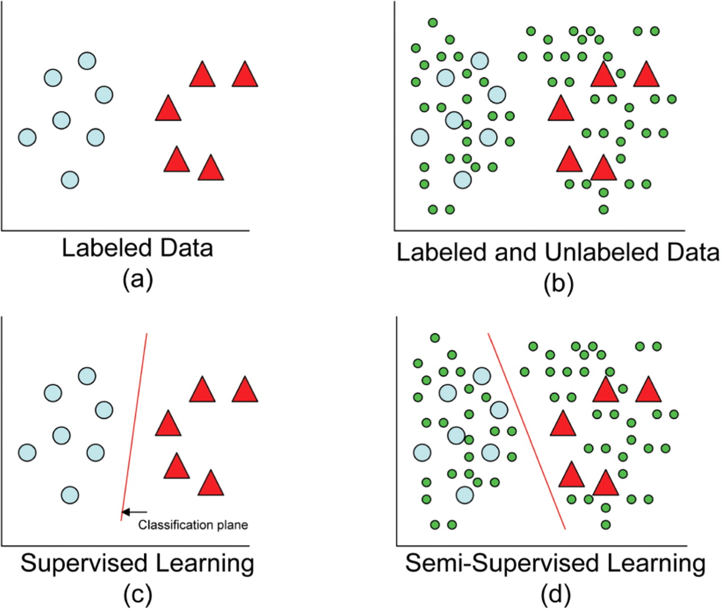
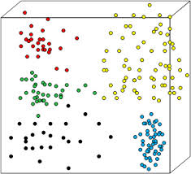
Visual examples of the taxonomy

Slide 15
Steps for a Machine Learning task
(Supervised)
Collect data and label every example(or someone gives a dataset to us)
Preprocess the dataset (or not)
Select features , so that you can represent every example in the dataset as a vector of features
Give the dataset to an algorithm to train the model
Evaluate the model(how strong the algorithm is , if errors are not many then you found a good model)
Use the model for predictions

Slide 16
Steps for our Email Filter
Dataset is given to you
Read every email and add it to a list
Give the list of emails to a Feature Selection module so that it can give us a list of features(features are words)
Give the list of emails to Naive Bayes Classifier and train the model
Test some emails , using our model

Slide 17
The Email class
Represents an electronic message
It contains:
  A content variable that stores the title+body of an email
  A category variable(will take values “HAM” , “SPAM”)
  A dictionary of words and their frequencies in the content
  An empty vector , so that we can represent the email later
  Useful methods(setters/getters,frequencies of words etc)

Slide 18
The Email class
Let's CODE the read() method!
Open the Email.py file

Slide 19
Feature Selection
&
Feature Vector

Slide 20
Feature Selection
Feature Selection is the extraction of important words from our dataset
We will later use the list of words we extracted in order to represent every item in the dataset.

Slide 21
Example
We have a collection of 2 emails
D1 = “Hello George” (this is a SPAM)
D2 = “George said hello to everybody and left” (this is a HAM)

Slide 22
Example – Step 1
Let's remove any stop-words
  We remove 'to' , 'and'
We transform every character to it's lower-case equivalent
The result is
  D1 = “hello george”
  D2 = “george said hello everybody left”

Slide 23
Example – Step 2
Calculate how many times every word appears
  hello = 2 , george = 2 , said = 1 , everybody = 1 , left = 1
Sort by frequency (from highest value to the lowest – here already sorted)

Slide 24
Example – Step 3
Output the list of words (features)
  [hello,george,said,everybody,left]

Slide 25
Open the exercise_features.py file
Select features

Slide 26
Feature Vector

Slide 27
What is a feature vector?
It is
  An m-dimensional vector of numerical features
  A representation of an object
We need it for
  Statistical analysis

Slide 28
Example
Remember the collection of 2 documents
We extracted a list of words from the collection
So we now have
  D1 = “hello george”
  D2 = “george said hello everybody left”
  Features = [hello,george,said,everybody,left]

Slide 29
Example
The 2 emails have different size
But!
  I can represent every email in the dataset using an array of size 5 (the size of my features array)
  So the two emails can be represented as 2 arrays of size 5 , each
Iterate through the list of features
  If a feature appears in an email put 1 to the current index of the email's array else put 0

Slide 30
Example –
Transformation from text to vector
hello george
<1,1,0,0,0>
george said hello everybody left
<1,1,1,1,1>
Features = <hello,george,said,everybody,left>

Slide 31
Open the exercise_features.py file
Transform the emails to vectors

Slide 32
Feature Selection
Feature selection
    is based on some complex mathematics
    specifically on Information Theory
    we will not analyze the idea.
What is given to you is a class that
  computes the mutual information(MI) of all the unique words in the collection of emails
  sorts the words according to the MI (from highest value to the lowest)
  selects the first 250 features.

Slide 33
Training the classifier

Slide 34
Important note
Artificial Intelligence and Machine Learning need math
Do not panic!!!
We need to calculate some probabilities
If you do not understand something , please do not panic
  We will see it in code!
  We will only need addition , division and multiplication to calculate the probabilities

Slide 35
Vocabulary - notations
P means probability
P(A|B) is translated
  Given B what is the probability of A?
  This is called Conditional probability

Slide 36
Training the classifier
Now we need to learn from our data , so
We will implement the Naive Bayes Classifier
  It is a probabilistic classifier based on applying Baye's Theorem and makes strong(naive) independence assumptions(i will clarify this in a moment)
Baye's Theorem

Slide 37
Training the classifier
C means Class
c is either “HAM” or “SPAM”
is the feature vector
We need to compute the term for a given c
Actually the above term is computed as follows

Slide 38
Training the classifier
So , we need to calculate the probabilities
In our example x is 1 if the feature exists and 0 if it does not.
Also c takes two values , either HAM or SPAM
So for every feature we have to calculate 4 probabilities

Slide 39
Training the classifier
So , we need to calculate the probabilities
In our example x is 1 if the feature exists and 0 if it does not.
Also c takes two values , either HAM or SPAM
So for every feature we have to calculate 4 probabilities

Slide 40
Computing the probabilities of features
P(x=1|HAM) , means
  In my training set, how many of my good emails contain x
P(x=0|HAM) means
  In my training set , how many of my good emails do not contain x
P(x=1|SPAM) means
  In my training set, how many of my bad emails contain x
P(x=0|SPAM) means
  In my training set, how many of my bad emails do not contain x

Slide 41
Computing the probabilities of features
Given the email is HAM
  The probability that x exists inside the email (top-left)
  The probability that x does not exist inside the email (bottom-left)
To compute the SPAM probabilities simply replace the word HAM(S) with SPAM(S)

Slide 42
Example
Features = ['hello','george',said,everybody,left]
D1 = <1,1,0,0,0> (SPAM)
D2 = <1,1,1,1,1> (HAM)
P('said'=1|HAM) = (1+1)/(2+1) = 2/3
P('said'=0|HAM) = (1+0)/(2+1) = 1/3
P('said'=1|SPAM) = (1+0)/(2+1) = 1/3
P('said'=0|SPAM) = (1+1)/(2+1) = 2/3

Slide 43
Scoring function
Once we learn the probabilities we can compute the function shown bellow to see if an email is SPAM.
For values close to 1 we are confident that email is SPAM and for values close to 0 we are confident that it is HAM

Slide 44
Time to implement our Classifier
so...

Slide 45


Slide 46
Let's DIVE into CODE!!!
Open the NaiveBayesClassifier.py file

Slide 47
References
http://en.wikipedia.org/wiki/Artificial_intelligence
http://www.aueb.gr/users/ion/docs/ceas2008_paper.pdf
http://arxiv.org/abs/cs.CL/0006013
More on Artificial Intelligence: AUEB's AI Course in http://eclass.aueb.gr/modules/document/document.php?openDir=/523315b129zh

Slide 48

Thank you all!
&
Thank you

